Slide 1
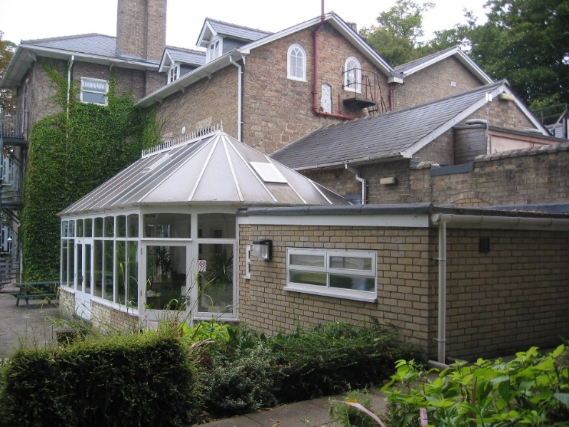
Burwell House
Year 4 Residential
January 26th–28th 2026

Slide 2
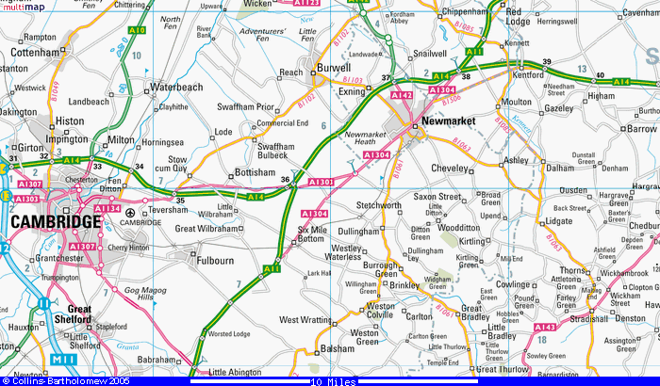
Where?

Slide 3
Where is Burwell?
Burwell is a village on the A1102 about 10 miles North of Cambridge
It is a relatively small village and is home to Burwell House which is a residential and day activity centre.

Slide 4
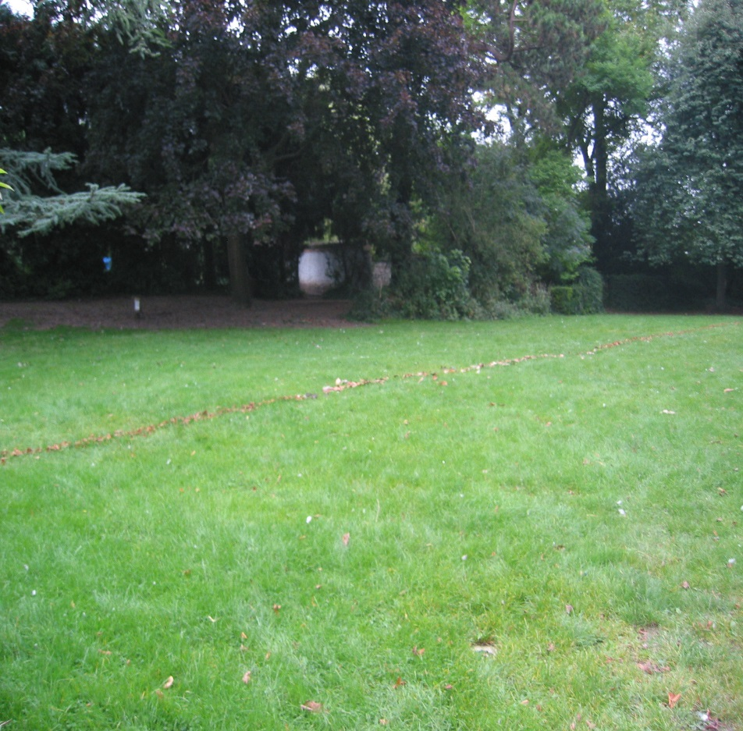
The purpose of our visit
To promote independence and taking responsibility for themselves and others.
To encourage teamwork through a range of activities – both indoors and outdoors.
For children to experience a couple of nights away from home in preparation for those who later attend Hilltop for a week in Year 6.

Slide 5
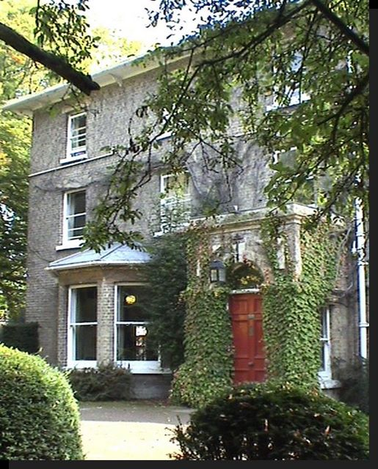
Come in…
Built in 1787
Originally a family home
Now owned by Cambridgeshire County Council
Residential programmes have been running here for 60 years

Slide 6
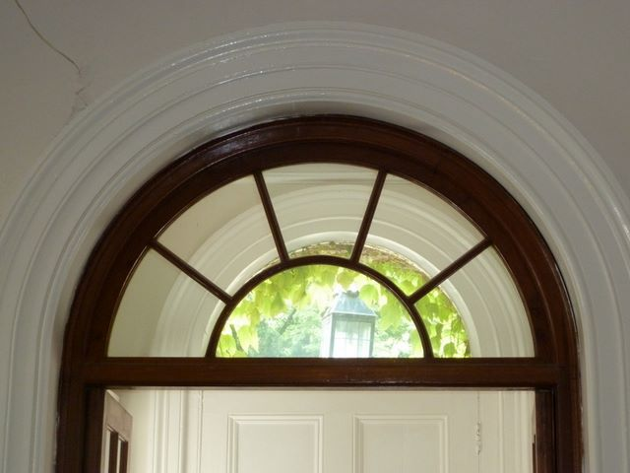
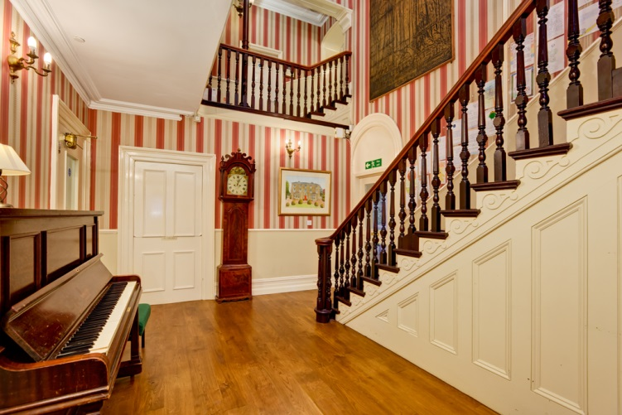
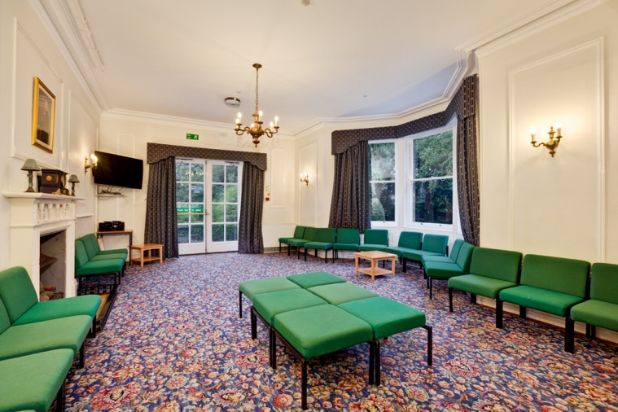
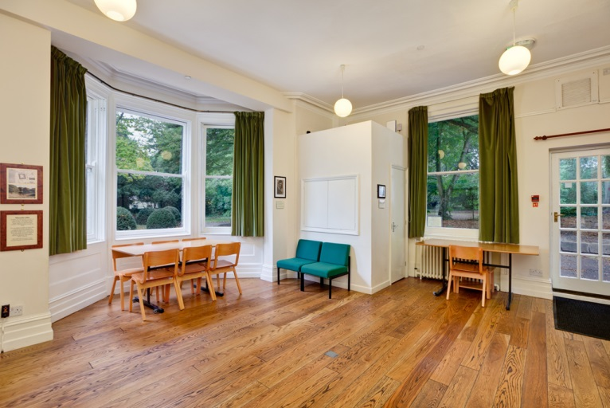
On the ground floor we have:
a large lounge
a smaller break away space (Mandeville Room)
separate toilets for boys, girls and accompanying adults
Cloakroom
Dining room
Conservatory

Slide 7
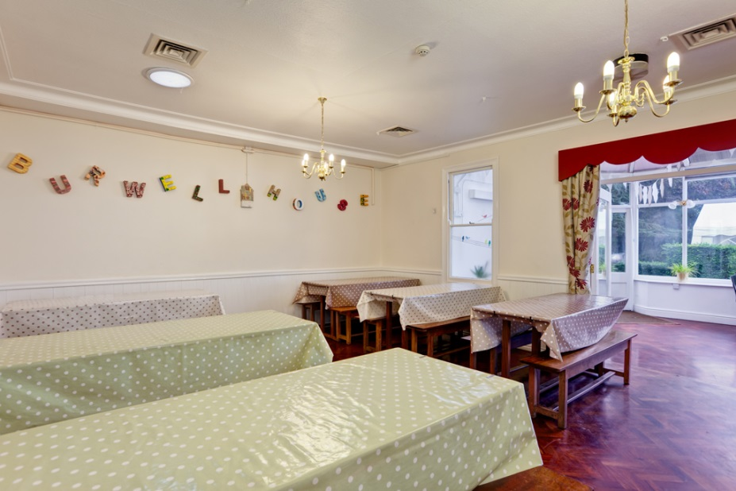
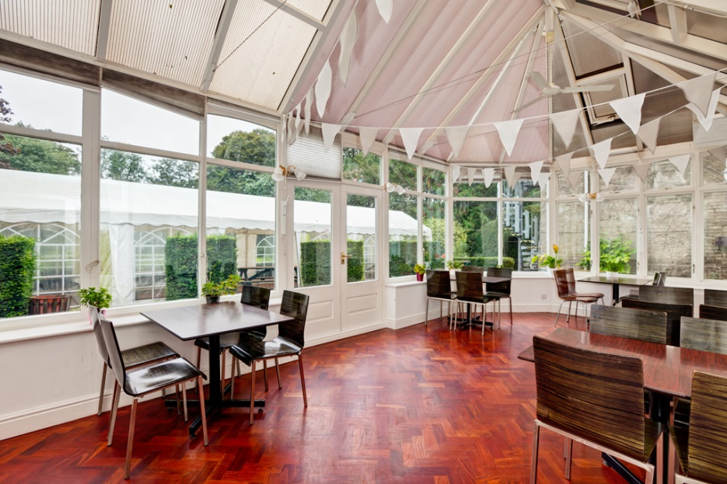
“The quality of the food and the general catering arrangements are excellent in every respect.”
Family style dining
Home cooked meals
- 2 hot meals a day

Slide 8
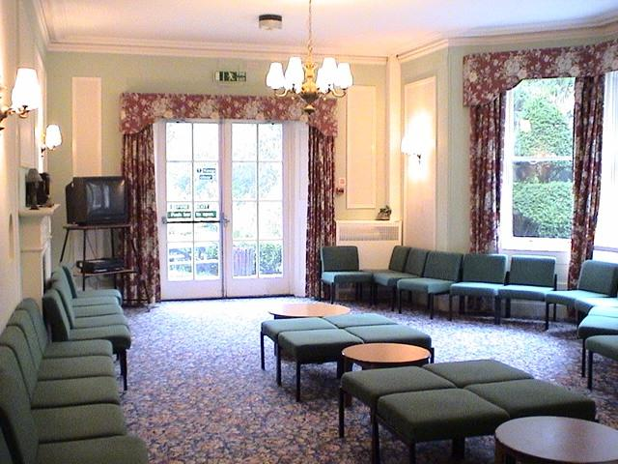
Evening
Children will spend the evening in the grounds and together downstairs in the lounges.
Activities will be organised by Pendragon staff.
A ‘Souvenir shop’ will be available for these times.
£5-10 limit

Slide 9
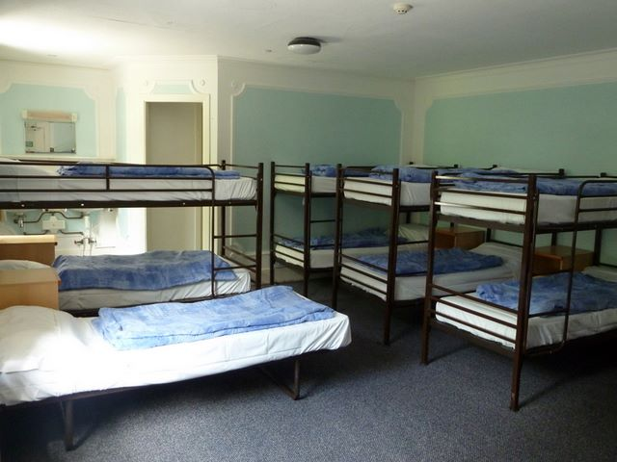
Bedrooms

Slide 10
Arrival day and day 2
Greeting and introduction
Orientation activity
Lunch
Activity 1
Refreshments
Activity 2
Children will be assigned to their dormitories and shown their facilities
Time to unpack and make the bed
5.30 Fire drill practice
Dinner 6.00pm
7.00pm – evening activity run by Pendragon staff.

Slide 11
Day 2
8.30: Breakfast
9.30am Activity 1
11.00am Refreshments and freetime
11.30am Activity 2
1.00pm Lunch and freetime
2.30pm Activity 3
4.00pm Refreshments and freetime
4.30pm Activity 4
6.00: Dinner
7.00: Evening activities

Slide 12
Day 3
Breakfast at 8.30am
Bags packed and ready
Activity 3
Burwell Fox
Lunch
Depart Burwell House

Slide 13
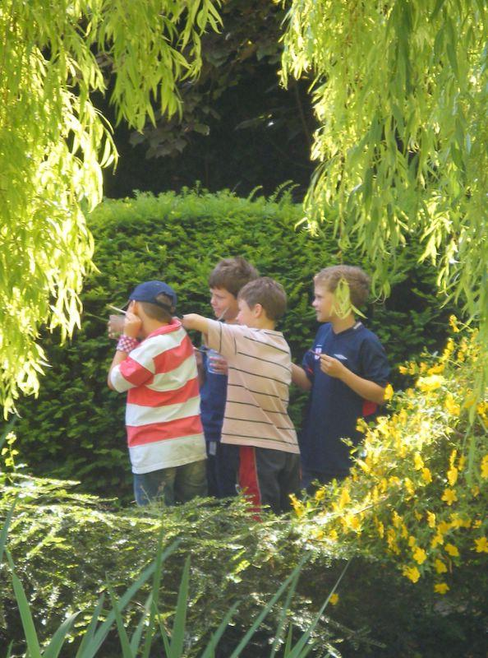
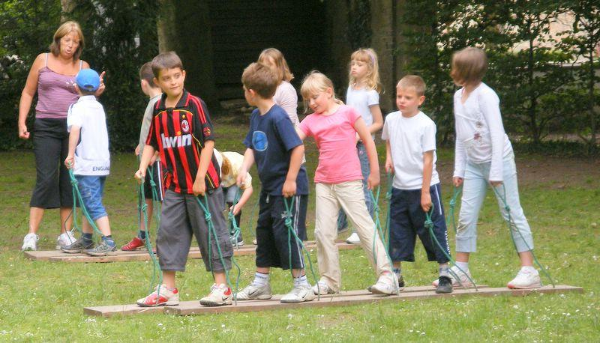
Activities
Burwell Fox
Orienteering
Team work
Batik

Slide 14
Code of practice
All activities are governed by Cambridgeshire County Council.
All staff are DBS checked.
Risk assessments are carried out for all centre run activities and shared with school staff.
Staff are fully trained in the activities they lead.

Slide 15
Expectations
To listen and follow instructions
To respect others working at and using the centre
To help keep themselves and others safe
To treat the centre’s buildings, furnishings and grounds with care
To have respect for the wildlife around the house and garden
To not go to out of bounds areas

Slide 16
First Aid/Medication
All the leaders at the centre are first aid trained and they have a comprehensive first aid kit
Children will be asked to go to a member of Pendragon staff for first aid treatment, which will be logged.
Any medication will also be logged and administered by a member of Pendragon staff. It needs to be handed in on the first morning with a consent form and be fully labelled with your child’s name.

Slide 17
Contacts
Pendragon staff will be in daily contact with school.
If there is a problem you will be contacted by either the office or one of the Pendragon staff at the centre.
Please ensure that you have signed the permission slips with emergency contact details and details of medication.
We will take lots of photos during the stay, please ensure photo permissions are up to date as these will be shared.

Slide 18
Cost
The cost of the trip is approximately £175.
Money for the shop (up to £10) to be placed in a named purse or envelope and handed into the staff on the first morning.

Slide 19
Finding out more
https://www.burwellhouse.com/
Check out the Burwell House diary on the website, it explores children’s worries and feelings and expectations – some of this will be done in school.
The website also has a great section for children to explore the house and find out more.

